Slide 1
Using AI to Validate Carbon Containment in Illinois Basin Machine Learning Challenge
Kanna Swaminathan

Slide 2
Objectives
EXPLORATION
Time series injection information, well and storage reservoir monitoring data on carbon capture well
MODELLING
Understand and process injection and monitoring information for predicting injection rates deltas
INSIGHTS
Correlating the change in injection rate to the behaviour of other parameters can be used to provide a checkpoint against carbon migration from well or other losses during process – predicted information can be used to validate carbon containment

Slide 3
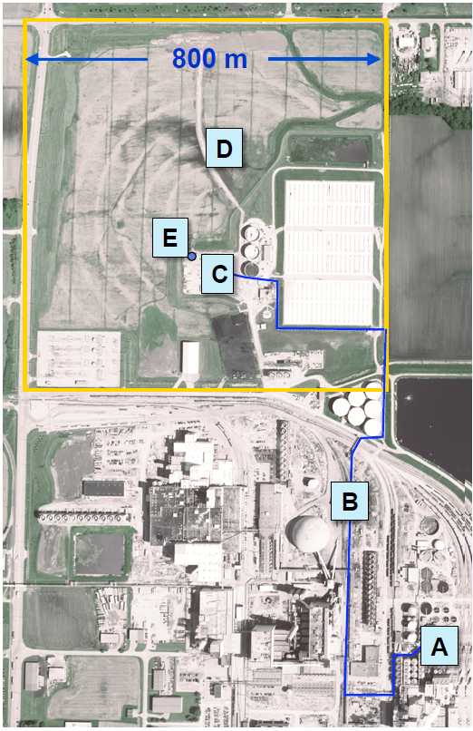
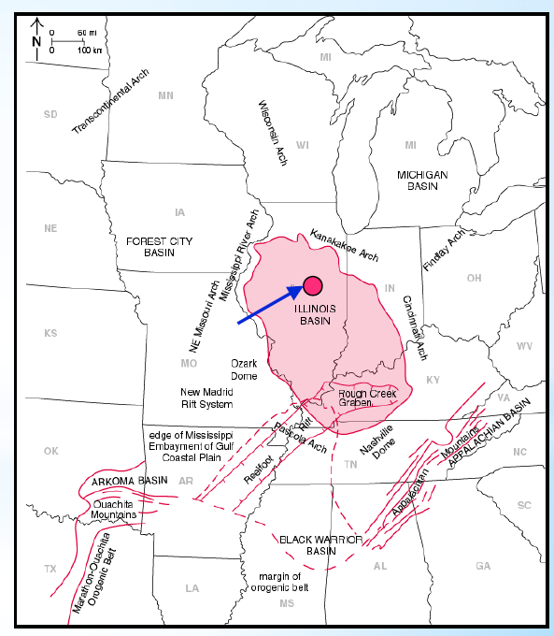
Background
Carbon Dioxide (CO2) released from ethonal production at the ADM (Archer Daniels Midland) Company’s plant was compressed, dehydrated and injected into the Mt. Simom Sandstone
Mt Simon Sandstone is a saline aquifer located in the Illinois Basin and is approximately ~7,000 ft deep
Over three years (Nov-2011 to Nov-2014), ~1000 tonnes/d of CO2 was injected into the reservoir
Cumulatively, 999,215 tonnes of supercritical CO2 was injected and has been geologically stored in Mt Simon Sandstone
A: Facility
B: Pipeline
C: Injection Well
D: Observation Well
C: Geophones
Source: Bauer et al, 2019
Source: modified from Locke, 2012

Slide 4
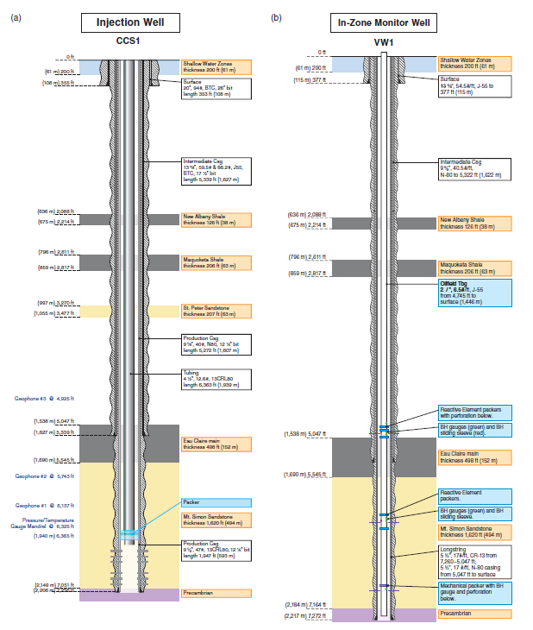
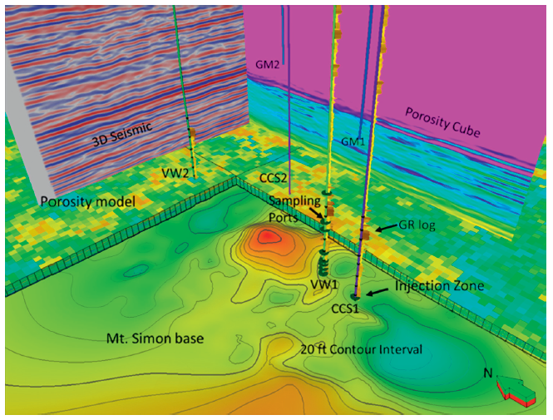
Data Collection
The injection and verification wells that are ~700ft apart are drilled downdip into the Mt Simon Sandstone
The wells were equipped with downhole sensors to monitor pressure and temperature at various depths of interest
Source: Bauer et al, 2019

Slide 5
Exploration
Methane Emissions
Rates, sources and measurement techniques

Slide 6



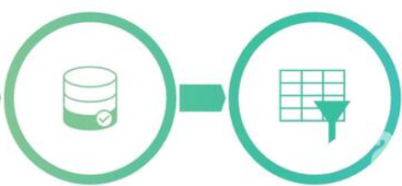




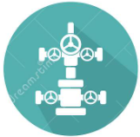



Methodology - Machine Learning
Data Collection
Data Preparation
Choose Learning Algorithm
Train the Model
Deployment/ Evaluation on a “Blind” Data Set
Test the Model

Slide 7
Dataset and Problem Framing
A total of 34 parameters measured in the injection and verification well
Parameters are comprised of both surface and downhole measurements
Target variable is the injection delta, defined as the difference in the injection rate at time t and time (t-1)
Dataset is available for full three years at hourly intervals (27,464 rows/hours)
27263 hours of data will be used to train a suitable model which will be use to predict 201 hours of injection delta in the future

Slide 8
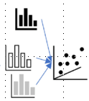
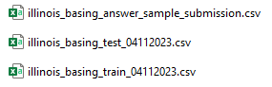
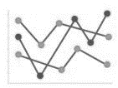
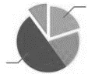

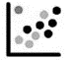
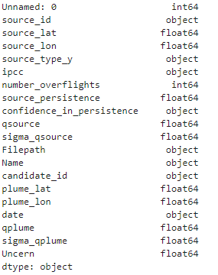
Exploratory Data Analysis
Exploratory Data Analysis
&
Statistics, grouping of variables, determining nature of variables
Load Data
Attributes?
Uni/ Bi/ Multivariant/ Statistics?
Missing Values, Aberrant, Outliers
Drop Data based on criteria
Relabel/Combine
Data Cleaning
X | Y
a | b |  | Z
a | b |  | c
a | b |  | NAN
a | b |  | NAN
a | b |  | NAN
 |  |  | NAN
Most time-consuming process; involved removing duplicates, fixing indexes, replacing incorrect characters, normalization of names etc
Notes:
Uni/ Bi/ Multivariant/ Statistics? Understanding unique values, duplicates

Slide 9
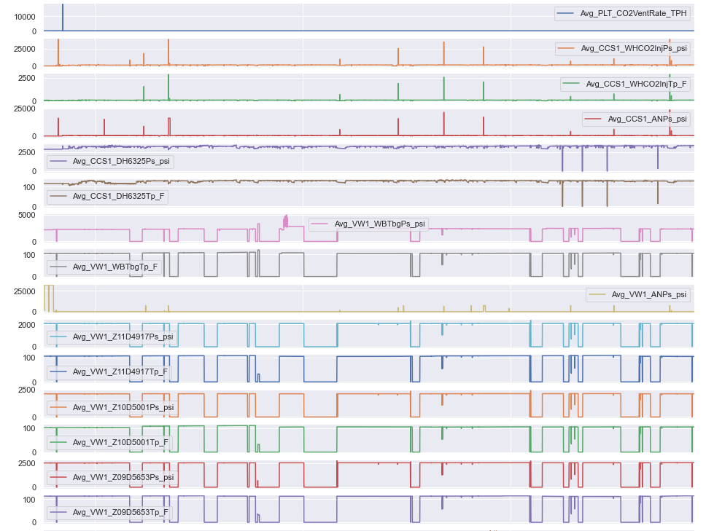
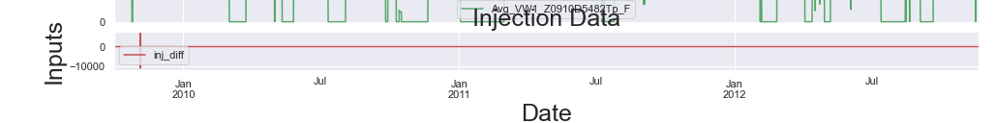
Data Orientation
Wealth of data available
Outlier presence
~25,000 psi WHP at injection well
0 psi downhole gauge pressure
Outliers likely caused by erroneous sensor readings/ reporting
Observation that there are variables with similar trends – correlatability check required
Target variable base is 0 psi. Deviation would result in –ve or +ve differences

Slide 10
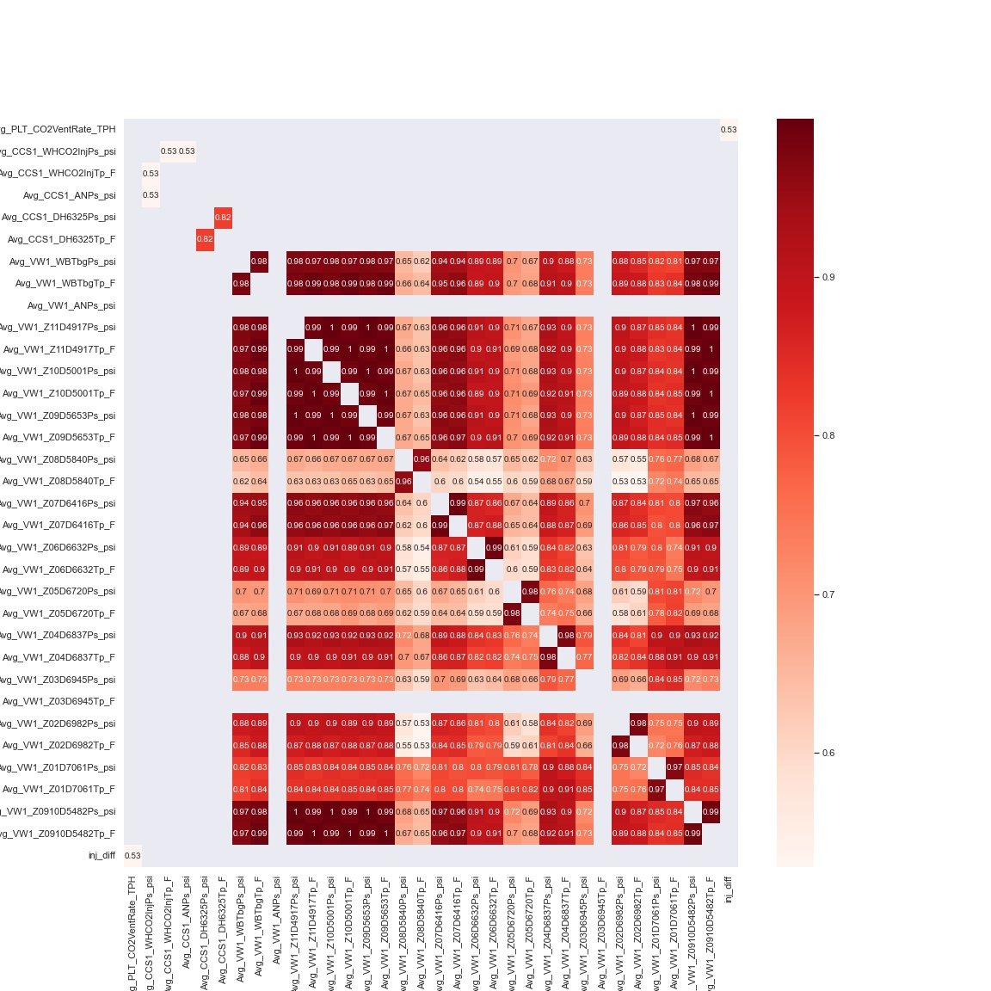
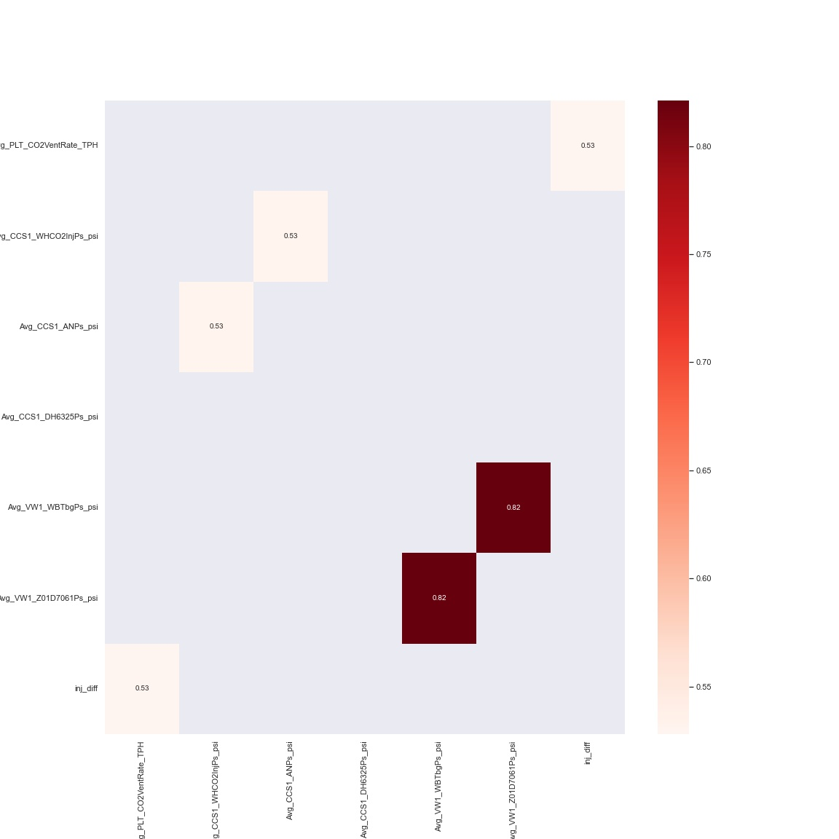
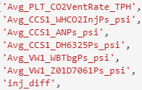
Data Selection
Most variables are highly correlatable, with values of > 0.5
Retained only one variable from groups of highly correleatable variables.
Exceptions are made if variables are found from different sources e.g. tubing and reservoir pressure at the observation well
Excluding the target injection delta variable, six variables retained for the machine learning application.
Notes:
Overall, it’s more impactful to focus on tackling the larger number of sources. Coal/Refinery still have actual rates that are higher

Slide 11
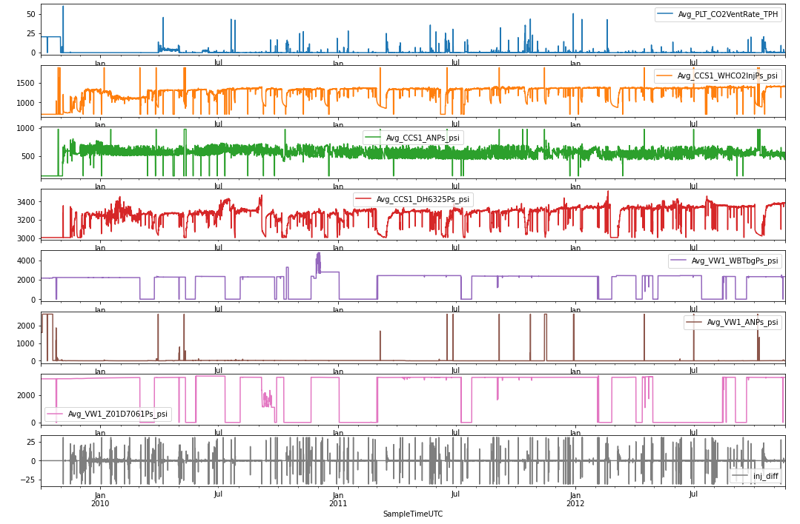
Outlier Removal
A modified Z-score is used to remove the outliers.
A more lenient score is used for injection delta and CO2 vent rate due to the difference in the magnitude’s range
The zero values at the observation well sensors have been kept – this will be tested for removal during the sensitization stage
Notes:
Overall, it’s more impactful to focus on tackling the larger number of sources. Coal/Refinery still have actual rates that are higher

Slide 12
Modelling
Selected Model and Injection Difference Prediction
LSTM

Slide 13
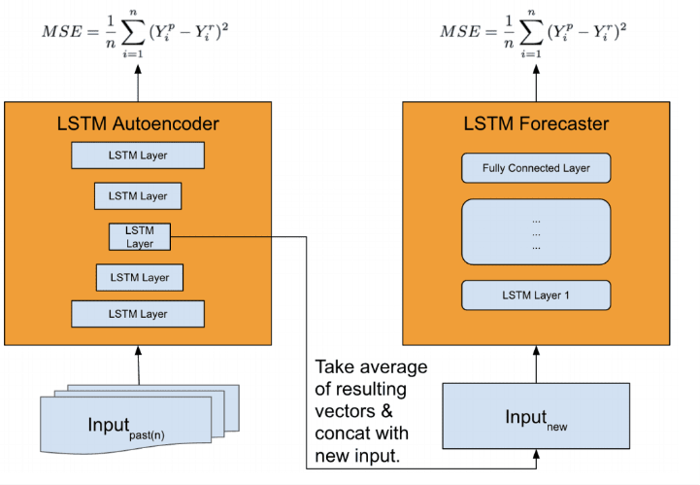
Selected Model – Long Short-Term Memory (LSTM)
LSTM is a type of recurrent neural network (RNN) that is capable of handling long-term dependencies in sequential data.
Architecture:
LSTM has a more complex architecture than traditional RNNs, with additional memory cells and gates.
Memory cells are responsible for storing information over time, and gates regulate the flow of information into and out of the cells.
Training:
LSTM is trained using backpropagation through time (BPTT), which involves unfolding the network in time and propagating errors backwards from the output to the input.
The gradients are computed using the chain rule and used to update the parameters of the network through optimization techniques such as stochastic gradient descent (SGD).
Source: https://machinelearningmastery.com/lstm-model-architecture-for-rare-event-time-series-forecasting/
Notes:
Final algo – HSV (worked better for the larger dataset)

Slide 14
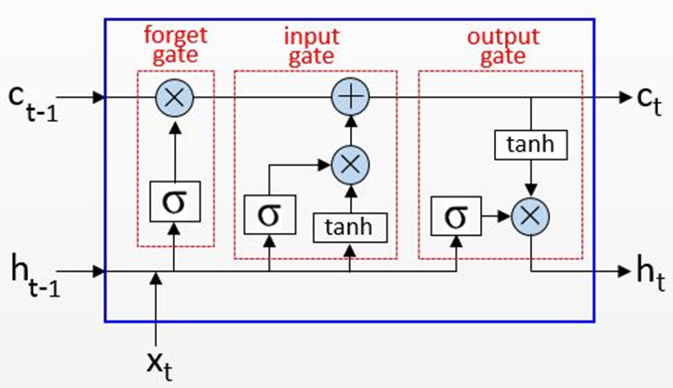
How LSTM works
Typical LSTM has 3 layers
Input gate which assigns weights based on the significance of different variables,
Forget gate to retain only useful information, and
Output gate which manages the information flow
LSTM holds a memory cell which retains captured information over longer time periods and preserves useful constituents using its input and forget gates, hence avoiding the vanishing gradient issue associated with traditional RNNs
Before building the LSTM model, the time series sequence must be split into samples.
The reason is due to LSTM’s nature of being a memory-based model, which retrieves information from sequences to create forecasts.
Note. By Rainardi, V., 2021, RNN and LSTM. Accessed at https://dwbi1.wordpress.com/2021/08/07/recurrent-neural-network-rnn-and-lstm/

Slide 15
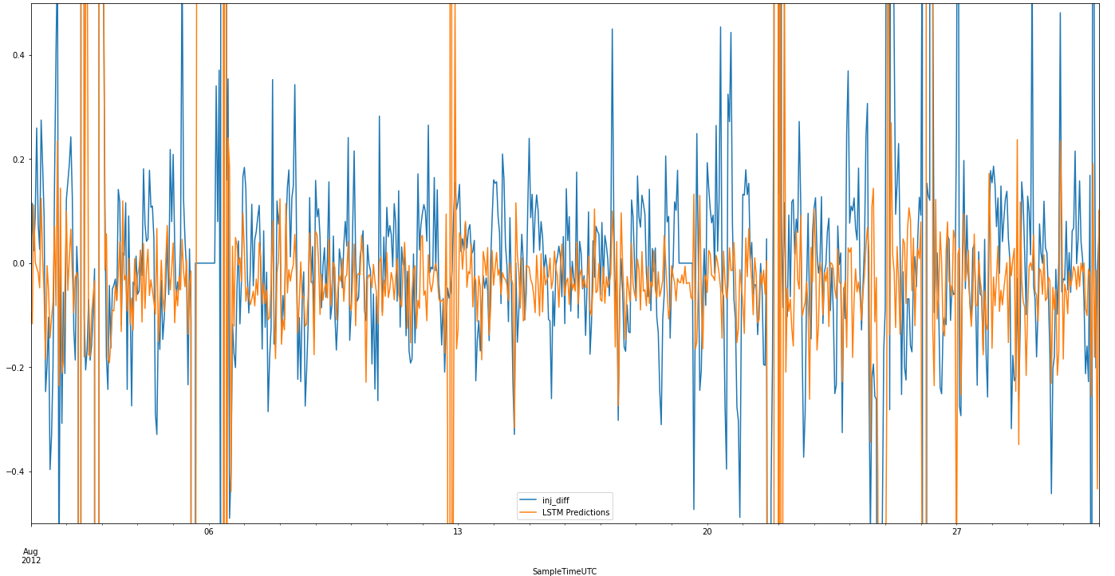
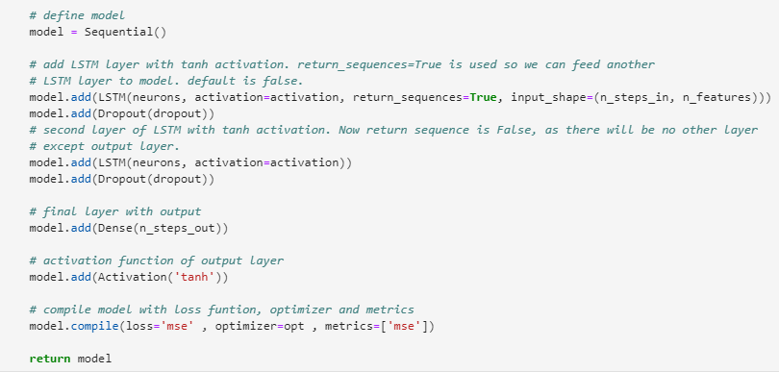
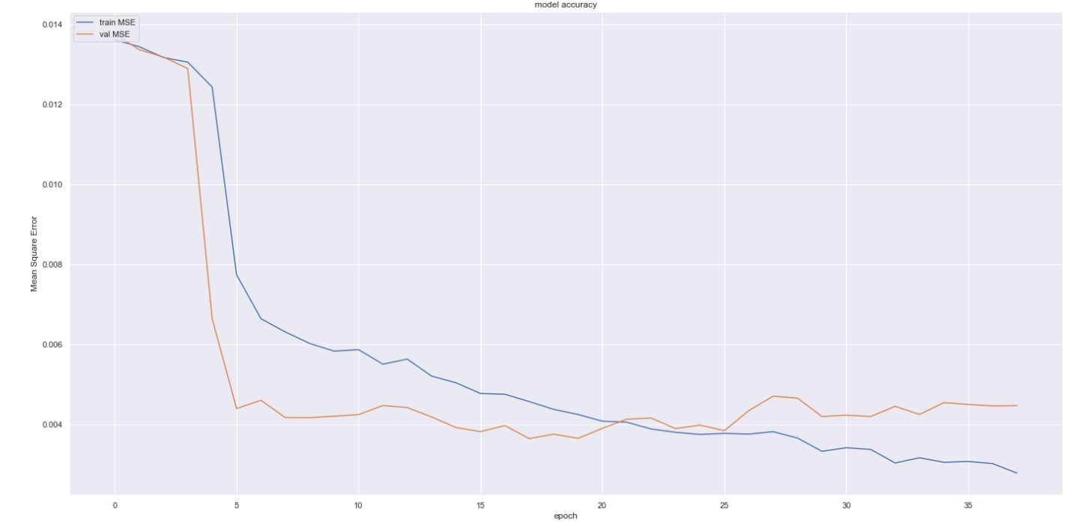
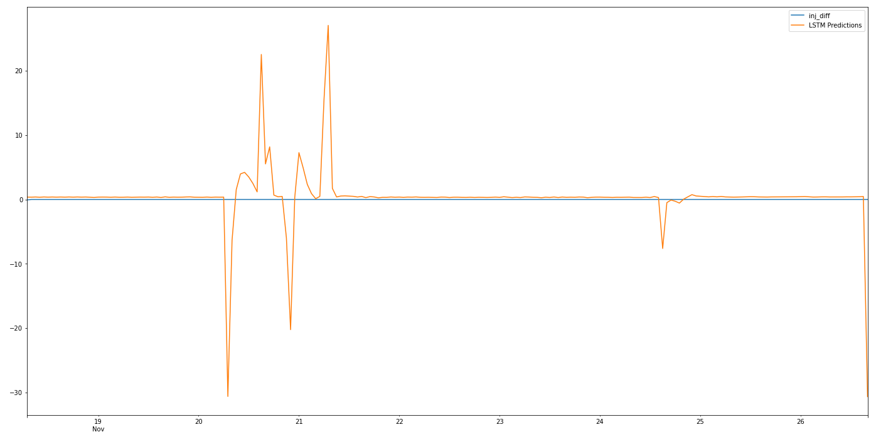
Modelling
Input – Train Data
LSTM Model
Model Evaluation/Validation
Input of blind test data, merging with existing train data and re-running model with new train data
Prediction
Notes:
Image on the left is the final output -> convert it into a 2d matrix (considers more features, parameters, consumes more resources)
Bottom (LR) less resources, simpler model, intensity of R, G & B in the final image

Slide 16
Data Modelling Results
Several sensitivities were run but only selected are displayed here
Best results (based on RMSE)
Scaling between -1 and 1
Use of DH sensor Z01 with corrected values of 0
Activation function tanh
Z-score outlier replacement of 20, resulting inj_diff range between 30 and -30.
Vintage | Select | Base | 3 | 4 | 5 | 6
Scaling | Y(-1,1) | Y(0,1) | Y(0,1) | Y(-1,1) | Y(0,1) | Y(0,1)
VW DH Sensor | Z01 | Z05 | Z01 | Z01 | Z01 | Z01
Z-Score Inj_Diff | 20 | 20 | 25 | 20 | 20 | 20
VW Zero Values | Yes | Yes | Yes | Yes | No | No
Activation | tanh | tanh | tanh | tanh | tanh | relu
Test RMSE | 1.92 | 2.64 | 2.50 | 2.50 | 2 | 2
Val RMSE | 1.75 | 1.75 | 2.22 | 1.88 | 2.05 | 1.55
Val R2 | 0.72 | 0.73 | 0.62 | 0.68 | 0.68 | 0.78
Sensitivities such as neurons, lookback, etc that are related to the model were previously optimized while selection of model with k-fold
Notes:
Best results: based on submission (unseen) RMSE data were achieved for a combined dataset where the image was processed using HSV filter
No transform was applied to the inputs
When filtering or data augmentation was run as a sensitivity, it worsened the prediction of the unseen data
However with the test dataset, filtering improved RMSE but the R2 decreased

Slide 17
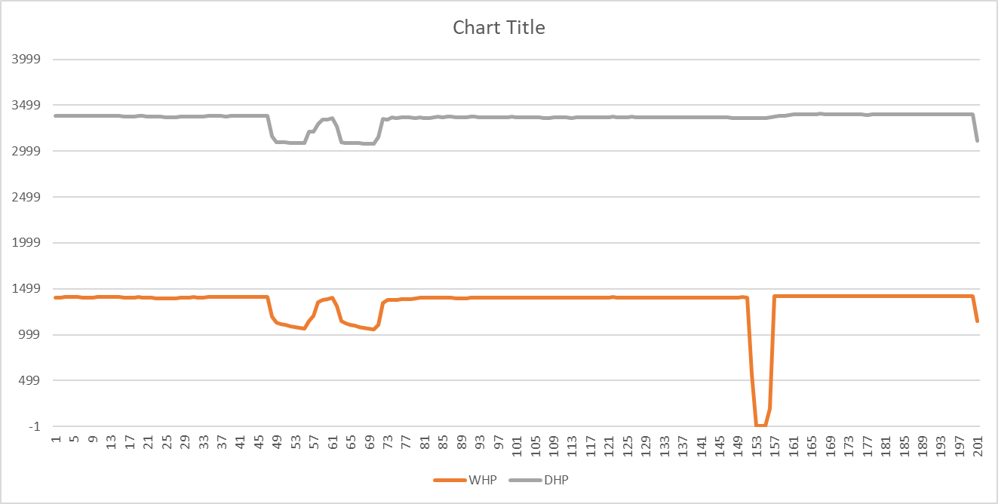
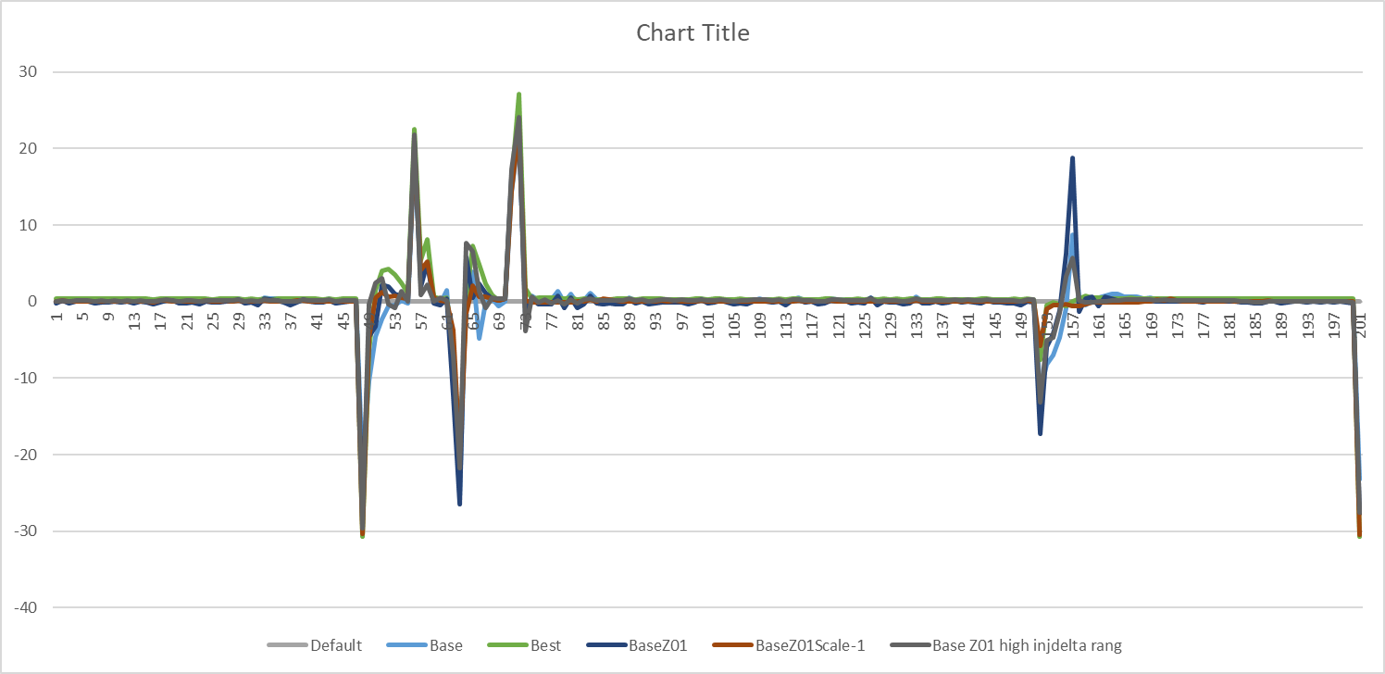
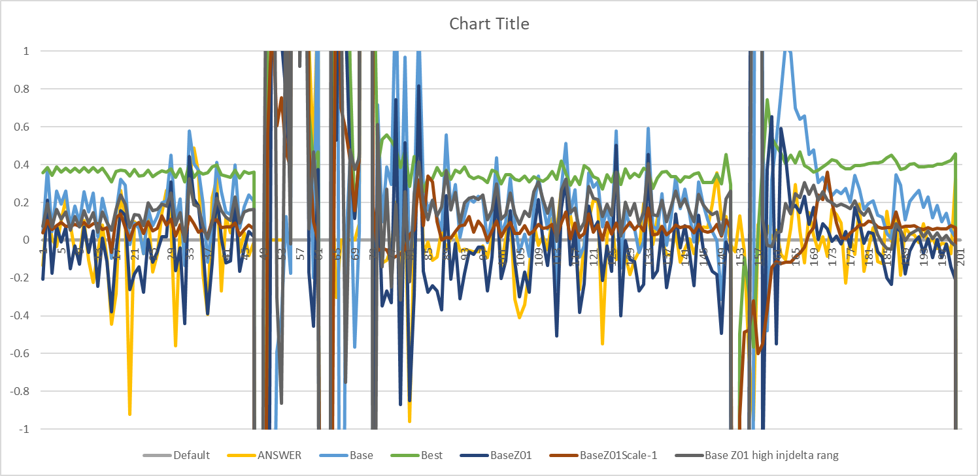
Predicted Injection Difference
Predicted models seem to do well with a good RMSE score
Able to pick out large anomalies thus meeting the objective of the challenge
Also able to predict small variation in rate due – thus proving to be robust

Slide 18
Model Optimization
Explore alternative models
Improved outlier removal / nan/zero replacements
Additional Data
Notes:
The model could be improved and optimised with
Data augmentation: 5 components from ChatGPT -> tried it once (didn’t improve) insufficient resources and time
Improved Image Processing: Filtering & Segmentation (computationally demanding)
Additional Data
Wind speed/direction (may have been factored in with uncertainty)
Elevation/Terrain
Climate differences across regions

Slide 19
Insights
What does the data tell us?
Insights from Data Analysis

Slide 20
Insights
Injected carbon is well contained, and no leakages based on data and model
Forecast anomalies are due to injection well shut-ins.
Blah blah blah
Notes:
Possible methods of mitigation:
- by understanding the patterns (by correlating the capacity of the facility and correlating with other factors, such as, the the 'persistence' of the emission) we can have more targeted and specific ways to reduce the emission.
e.g. a consistent amount of emission even when production is not happening could be due to leaks.
a steady increase in the emissions with no change in production could indicate that it is time for preventive maintenace
A huge unexpected spike could indicate the inefficiency or failure of a motor/equipment.
Foster Cooperation & Encourage behaviour with Policy
- correlating the industry to emissions (within a region) could help us to understand what is the "expected efficiency" or "expected emissions" of an industry.
we can tackle this by motivating the best performing companies to share/license their best practices with other companies
we can also (by creating an open market) provide incentives for larger companies to help pay for maintaining the efficiency of smaller players (who may be more selective in spending on maintenance). In this way, they can earn carbon credits which can be traded on the open market or used to offset their own emissions.
- selling the methane (carrot)
- selling the carbon credits (carrot)

Slide 21
995, 215
~1000 tonnes/day
xxxx
CO2 injection for three year in one well
Total tonnes of CO2 injected into one well
Blah blah blah

Slide 22
Thank you all!
Happy to share more about our algo and journey, feel free to reach out to us
Please keep this slide for attribution

Slide 23
References
Blah blah balh

